Slide 1
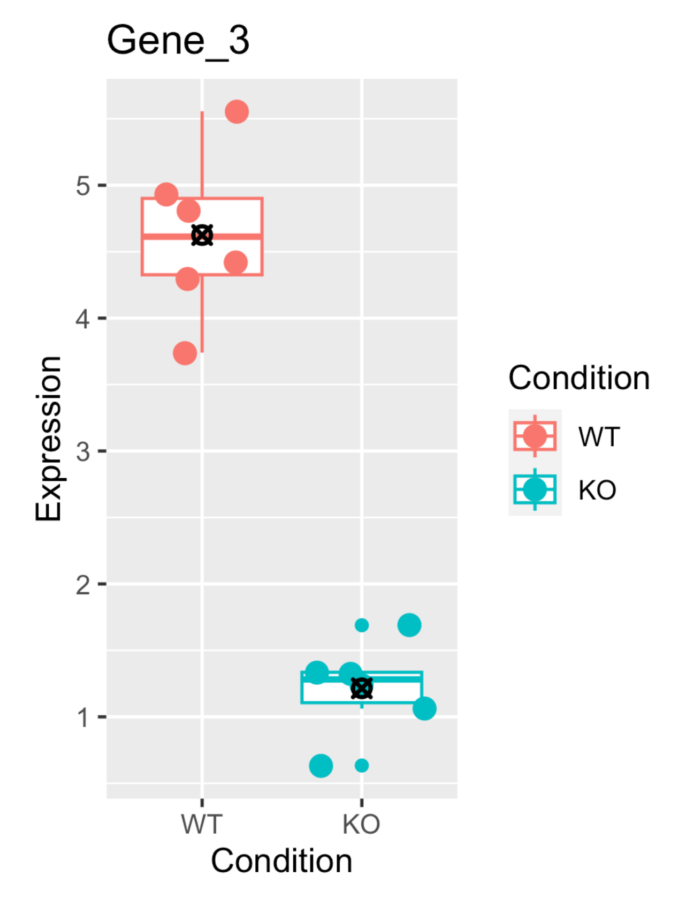
According to a PCR test, Gene_3 is differential expressed
The probability of seeing a difference this extreme under the null hypothesis is <= 5%, so…
P-value = 0.05

Slide 2
pvalue = 0.10
0.80
0.95
0.25
0.65
Not statistically significant at alpha = 0.05
Statistically significant at alpha = 0.05
0.60
0.35
0.85
0.20
0.75
0.55
0.15
0.70
Gene N
With an alpha (threshold) of 0.05, we expect 1/20 results to be false positives.
0.05
0.40
0.50
0.90
0.10
0.45
0.30
Notes:
After testing 20 genes, we can see that Gene N is differentially expressed. (Right???)

Slide 3
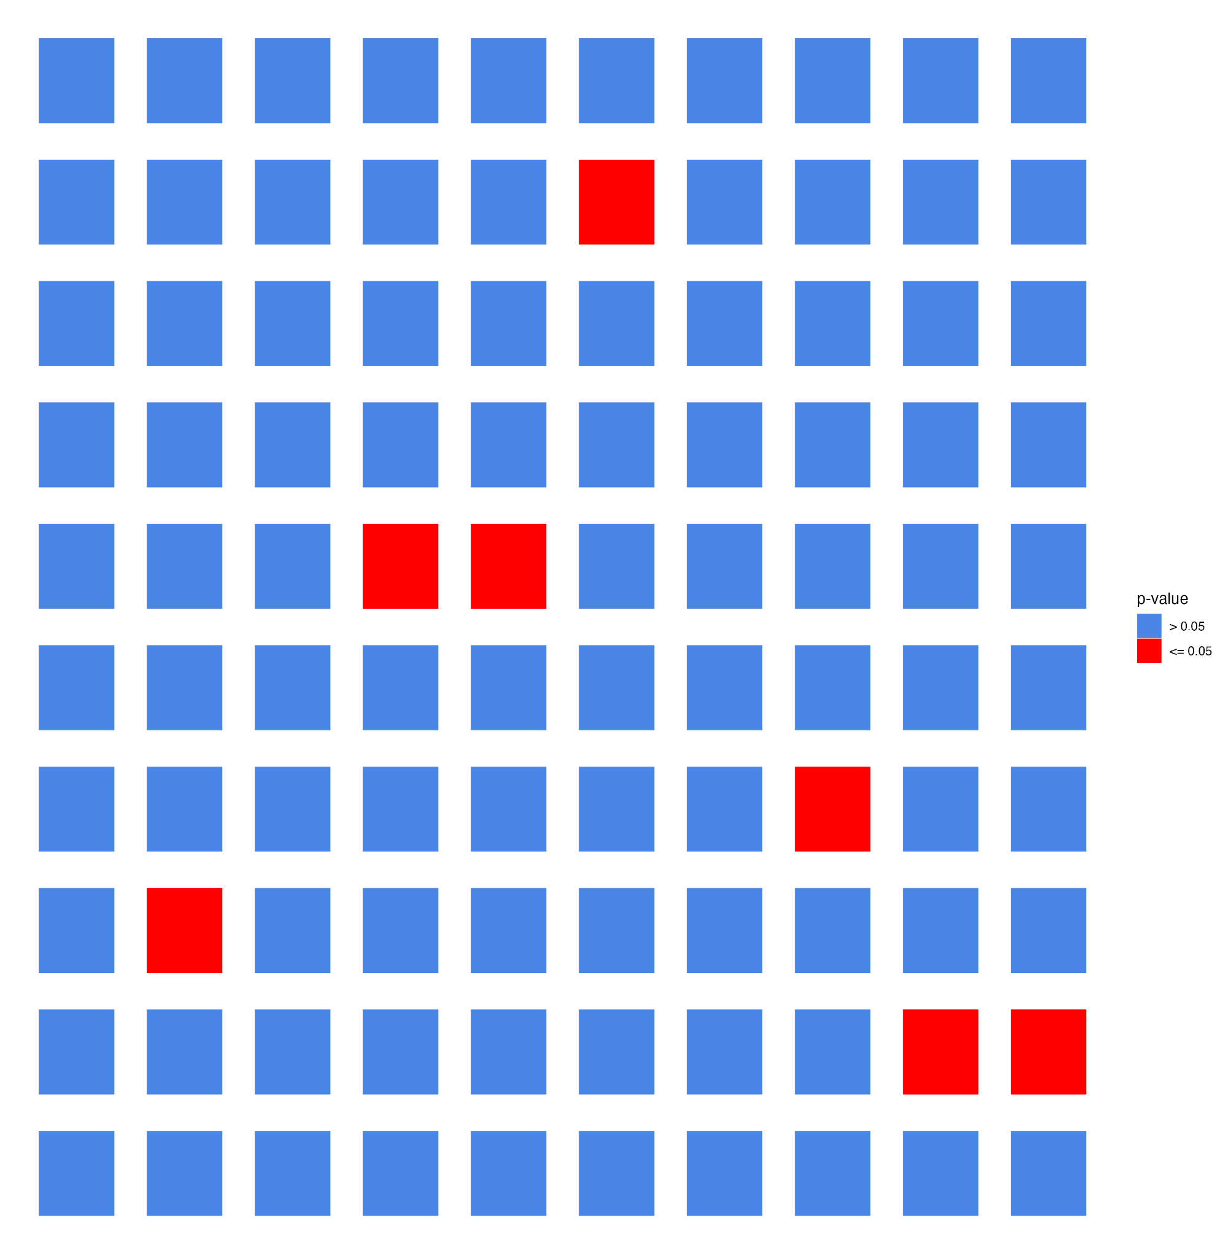
Notes:
What if we tested 100 genes? How many genes would we expect to be < 0.05 just by chance?

Slide 4
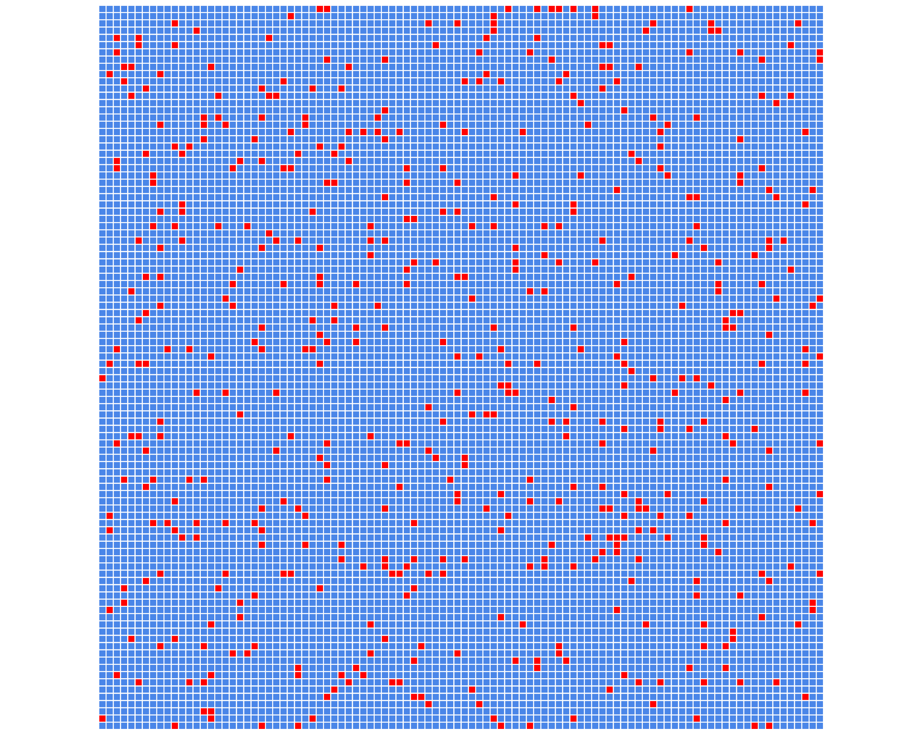
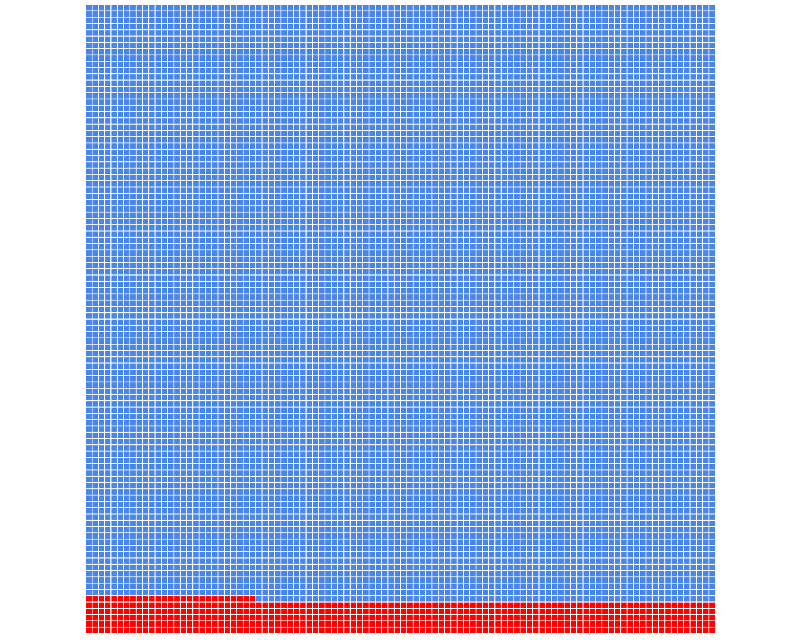
Same as left but visually grouping
p-value <0.05 together
Notes:
What if we tested 10,000 genes? ~500 sig results by chance!

Slide 5
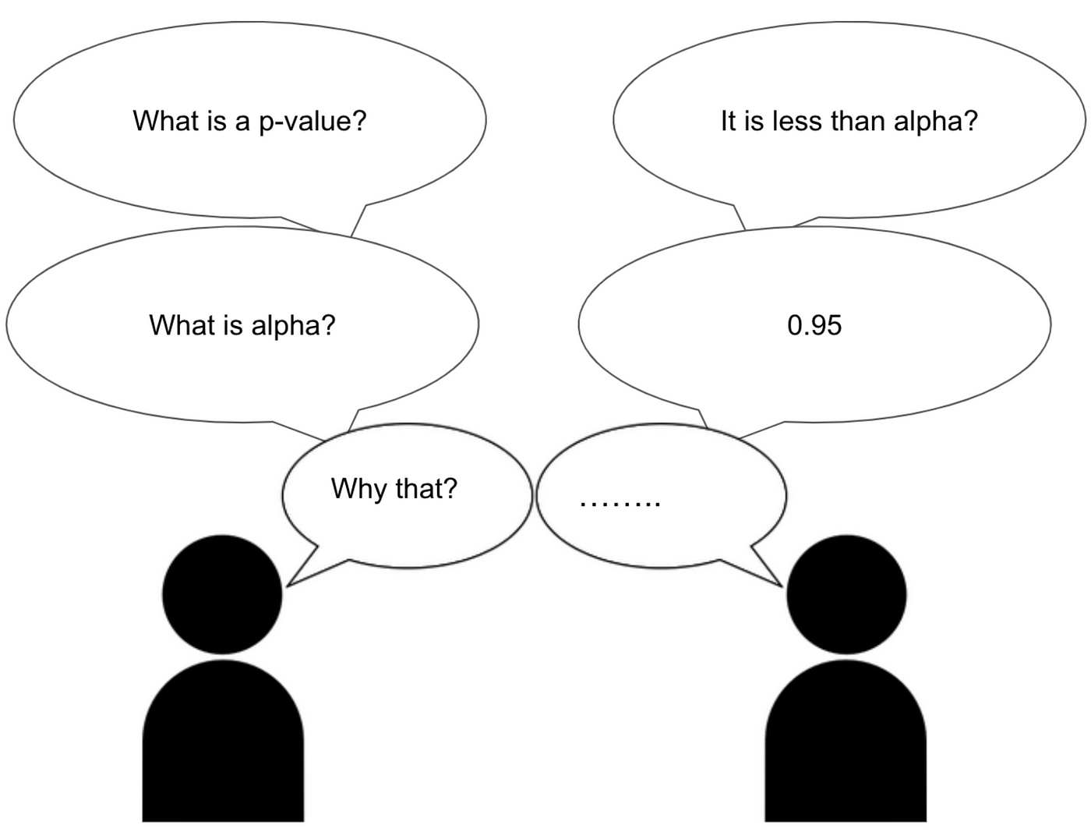


Slide 6























Slide 7
Exciting news! And with 95% confidence! But how did researchers reach this conclusion?

Slide 8
If the full results looked like this, how would that impact how we view the published claims?
jelly bean color | p-value
Purple | 0.10
Brown | 0.09
Pink | 0.64
Light Blue | 0.32
Aqua | 0.07
Rust | 0.21
Red | 0.58
Blue-Green | 0.49
Brown | 0.09
Peach | 0.61
jelly bean color | p-value
Grey | 0.57
Sienna | 0.99
Lime Green | 0.08
Green | 0.02
Orange | 0.21
Tan | 0.37
Blue | 0.81
Black | 0.49
Yellow | 0.74
Dark Aqua | 0.91
What are the dangers of using the “nominal” p-value when dealing with large scale data?

Slide 9
Exciting news! And with 95% confidence! But how did researchers reach this conclusion?

Slide 10
If the process looked like this, should we believe the published claims?
What are the dangers of using the “nominal” p-value when dealing with large scale data?

